Slide 1
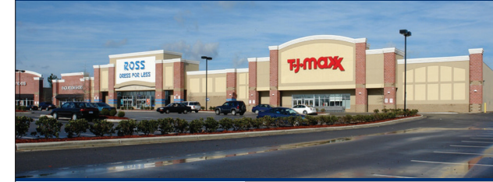
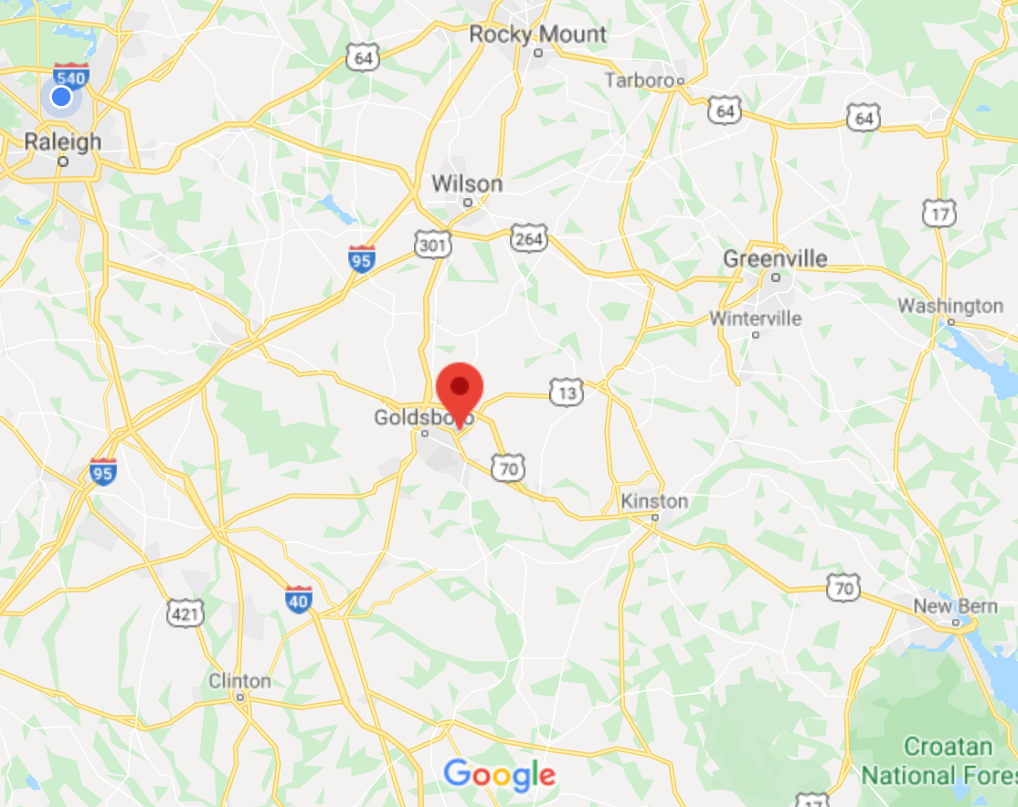
BERKELEY COMMONS
1203-1303 BERKELEY BOULEVARD, GOLDSBORO, NC 27534
Total SF: 137,316
HIGHLIGHTS
Excellent co-tenancy with ALDI, TJ Maxx, Ross Dress for Less, Rack Room Shoes, Old Navy and more
Low operating expenses of $4.00 PSF
625 parking spaces
Located just east of US Highway 70
In proximity to Lowe’s, Sam’s Club, Target and Berkeley Mall
NEC of N Berkeley Blvd. and Parkway Dr.
24,000 VPD on N Berkeley Blvd.
FOR LEASE
60 miles
DEMOGRAPHICS
Radius: | 1-Mile | 3-Mile | 5-Mile
Population | 5,409 | 28,845 | 48,162
Households | 2,517 | 11,993 | 20,030
Avg HH Income | $58,580 | $54,189 | $52,225
Employees | 7,776 | 24,783 | 38,378
40 miles
Steve Ellis Steve@BellCommercial.net 336.209.2562
Bell Commercial Inc. All rights reserved. The information above has been obtained by sources deemed reliable. While we do not doubt its accuracy, we have not verified it and make no guarantee, warranty, or representation of it. It is your responsibility to independently confirm its accuracy and completeness. You and your advisors should conduct a careful, independent investigation of the property to determine to your satisfaction the suitability of the property for your needs.

Slide 2
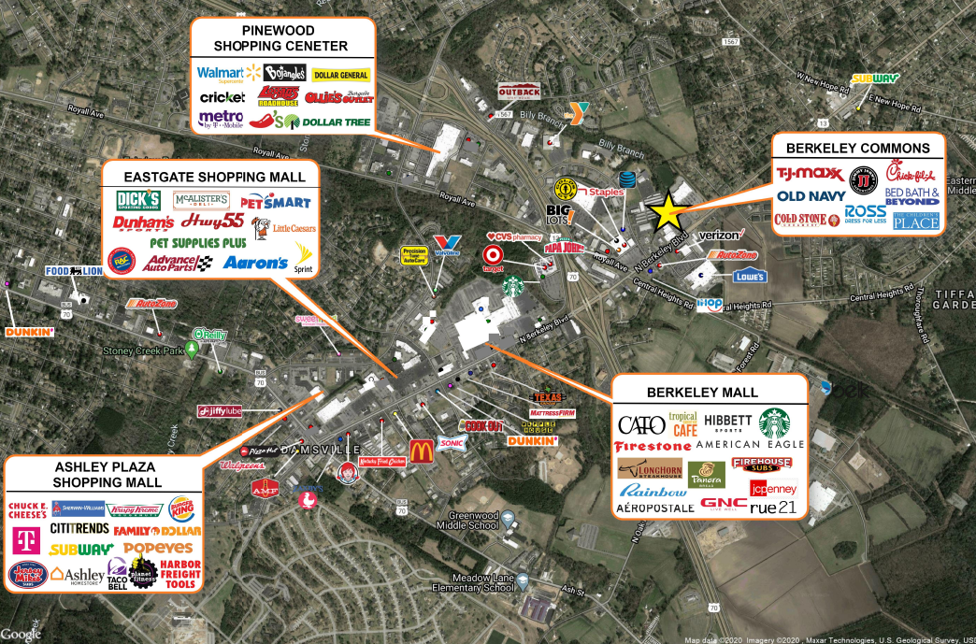
MARKET AERIAL
Berkeley Commons Goldsboro, NC 27534
Steve Ellis Steve@BellCommercial.net 336.209.2562
Bell Commercial Inc. All rights reserved. The information above has been obtained by sources deemed reliable. While we do not doubt its accuracy, we have not verified it and make no guarantee, warranty, or representation of it. It is your responsibility to independently confirm its accuracy and completeness. You and your advisors should conduct a careful, independent investigation of the property to determine to your satisfaction the suitability of the property for your needs.

Slide 3
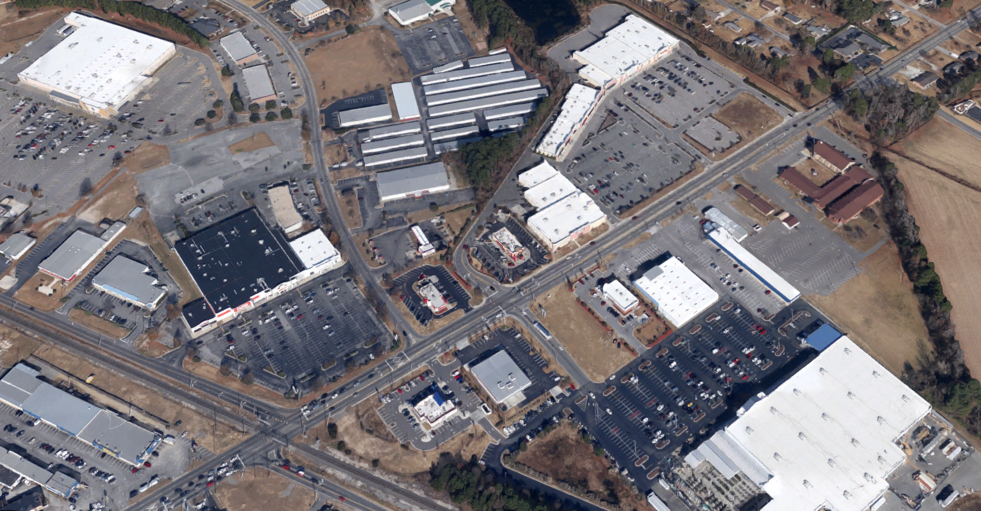
SITE AERIAL
Berkeley Commons Goldsboro, NC 27534
BERKELEY COMMONS
AADT: 24,000
Steve Ellis Steve@BellCommercial.net 336.209.2562
Bell Commercial Inc. All rights reserved. The information above has been obtained by sources deemed reliable. While we do not doubt its accuracy, we have not verified it and make no guarantee, warranty, or representation of it. It is your responsibility to independently confirm its accuracy and completeness. You and your advisors should conduct a careful, independent investigation of the property to determine to your satisfaction the suitability of the property for your needs.

Slide 4
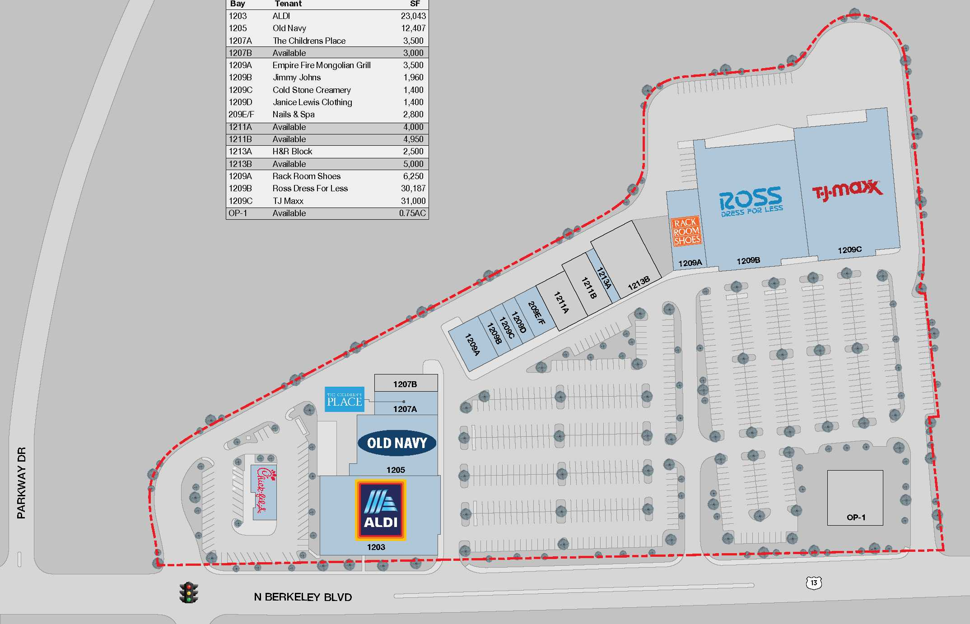
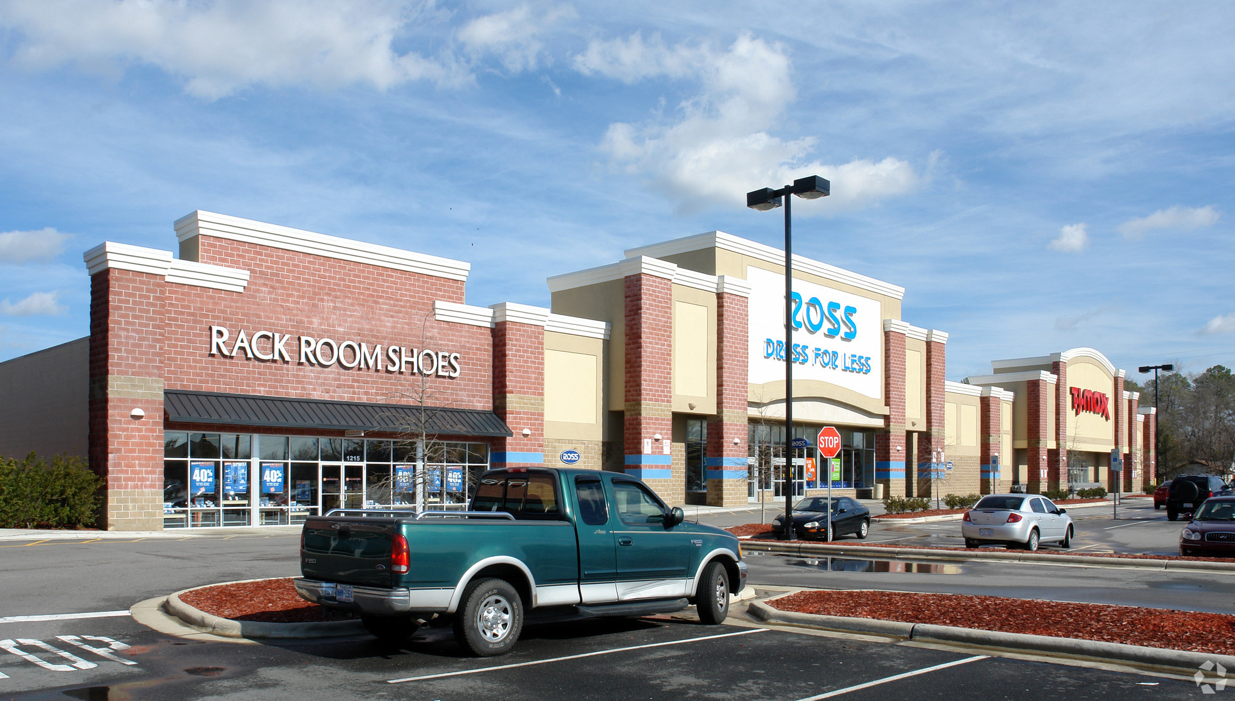
SITE PLAN & RETAIL AVAILABILITY
Berkeley Commons Goldsboro, NC 27534
RETAIL SPACE AVAILABLE
BAY TENANT SQ FT
1203
1205
1207A
1207B
1209A
1209B
1209C
1209D
209E/F
1211A
1211B
1213A
1213B
1209A
1209B
1209C
OP-1
ALDI
Old Navy
The Childrens Place
AVAILABLE
Empire Fire
Mongolian Grill
Jimmy Johns
Cold Stone Creamery
Janice Lewis Clothing
Nails & Spa
AVAILABLE
AVAILABLE
H&R Block
AVAILABLE
Rack Room Shoes
Ross Dress For Less
TJ Maxx
AVAILABLE
23,043
12,407
3,500
3,000
3,500
1,960
1,400
1,400
2,800
4,000
4,950
2,500
5,000
6,250
30,187
31,000
.75 AC
5,000 SF
4,950 SF
4,000 SF
3,000 SF
1213A
0.75 AC
Steve Ellis Steve@BellCommercial.net 336.209.2562
Bell Commercial Inc. All rights reserved. The information above has been obtained by sources deemed reliable. While we do not doubt its accuracy, we have not verified it and make no guarantee, warranty, or representation of it. It is your responsibility to independently confirm its accuracy and completeness. You and your advisors should conduct a careful, independent investigation of the property to determine to your satisfaction the suitability of the property for your needs.

Slide 5
DEMOGRAPHIC RADIUS MAP
Berkeley Commons Goldsboro, NC 27534
5-mile
3-mile
1-mile
Steve Ellis Steve@BellCommercial.net 336.209.2562
Bell Commercial Inc. All rights reserved. The information above has been obtained by sources deemed reliable. While we do not doubt its accuracy, we have not verified it and make no guarantee, warranty, or representation of it. It is your responsibility to independently confirm its accuracy and completeness. You and your advisors should conduct a careful, independent investigation of the property to determine to your satisfaction the suitability of the property for your needs.

